Slide 1

CAPSTONE BANK ANALYSIS REPORT
Authored by: Mayank Chandrakar

Slide 2
INTRODUCTION
As an analytical CRM specialist entrusted by Capstone Bank to delve into our customer-related datasets, I am excited to present insights aimed at fortifying our customer relationships and bolstering our service delivery. In today's presentation, we will explore how strategic CRM analysis can be instrumental in reducing customer churn, optimizing service provision, and ultimately, elevating customer satisfaction levels.
With access to diverse datasets encompassing customer demographics, transaction histories, exit information, and active customer profiles, we are equipped with a wealth of valuable information. Through meticulous analysis and interpretation, we aim to uncover patterns, trends, and correlations that illuminate the factors influencing customer behavior and loyalty within our banking ecosystem.
.

Slide 3
Our overarching goal is to utilize these insights to inform targeted strategies and initiatives that foster stronger customer connections and drive sustainable growth for Capstone Bank. By harnessing the power of data-driven decision-making, we aspire to not only retain our valued customers but also to exceed their expectations, thereby solidifying our position as a trusted financial partner in their lives
Throughout this presentation, we will navigate through key findings derived from our CRM analysis, highlighting actionable recommendations that have the potential to yield tangible improvements in customer retention rates, service quality, and overall satisfaction levels. Together, let us embark on this journey of exploration and innovation as we strive to unlock the full potential of our customer relationships.

Slide 4
Geographic Locations
2477
Spain
France
Spain is the region having smallest count of customers
France is the region which has highest customers
5014
2509
Germany
Germany is the region which has second largest customers

Slide 5

Gender Distribution
Male
Female
Male has 2867 active accounts.
Female has 2284 active accounts.

Slide 6
AGE Category
18-30
30-50
50+
There are 1641 customers belong to
18-30.
There are 7000 customers belong to
30-50 which consist of highest customer count.
There are 1395 customers above 50.

Slide 7
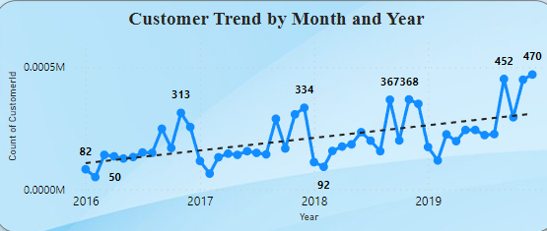
The graph demonstrates that there is a recurring pattern in which the churn rate reaches its highest point in September & October towards the end of each year. Conversely, January and February consistently show lower churn rates in comparison. rates.

Slide 8
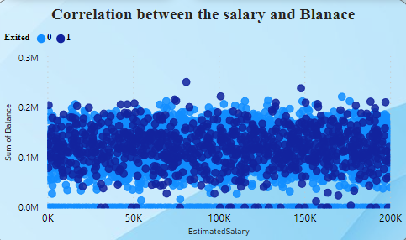
Based on the analysis depicted in the provided data visualization, it can be inferred that while there appears to be an increase in salary for both retained and exited customers, there is minimal impact on account balances. Consequently, it suggests that there is no clear direct correlation between salary and account balance...

Slide 9
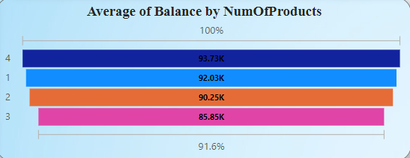
Analysis indicates that customers who either purchase 4 products or only 1 product exhibit a higher likelihood of exiting the bank. To address this, a potential solution could involve incentivizing customers to maintain a product count within the range of 1 to 4. This strategy aims to promote a balanced portfolio and potentially mitigate churn rates.

Slide 10
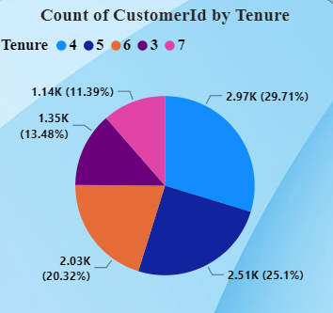
The presentation highlights the relationship between customer age, credit score, and their lifetime value to the bank. It reveals a pattern where customers joining between the ages of 18-30 tend to have lower credit scores initially, reflecting their recent entry into financial services. As customers age into the 30-50 bracket, their credit scores rise, indicating a potentially profitable relationship for the bank. However, in the 50+ age group, credit scores may decline as these customers may be less inclined to engage in extensive banking activities.

Slide 11
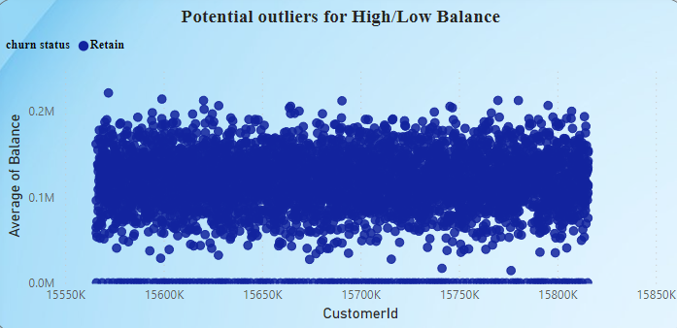
The majority of customers who do not maintain four products are typically retained by the bank.

Slide 12
Credit Card Holders
There are 2434 Customers having credit cards.
EXIT
Retain
There are 925 customers exits the bank.
There are 2180 customer retained in the bank
ACTIVE
ACTIVE
Not ACTIVE
NOT ACTIVE
1549 customers
1349 customers
695 customers
409 customers

Slide 13
CREDIT SCORE WORTHINESS
CREDIT SCORE RANGE | CREDIT WORTHINESS | CUSTOMERs COUNT
300-579 | POOR | 520
580-669 | FAIR | 685
670-739 | GOOD | 452
740-799 | VERY GOOD | 252
800-855 | EXCELLENT | 128

Slide 14
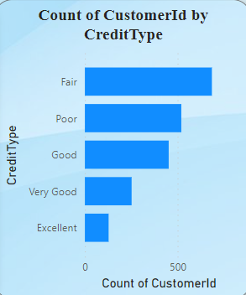

Slide 15
YEAR WISE CHURN RATE
2016
2017
376 customers have exited in the year 2016
479 accounts are exited
2018
2019
In the year 2018, 524 accounts have been churned
We are facing highest churn rate as 658 accounts in the current year

Slide 16
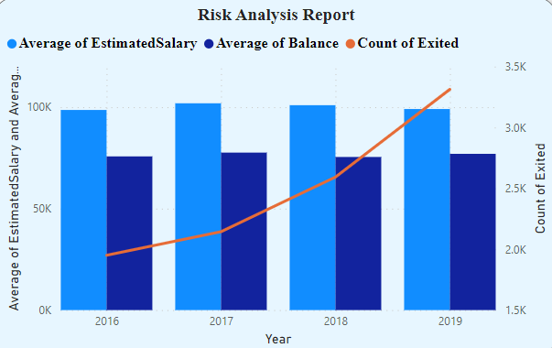
RISK ANALYSIS
The decision to focus on demographic segmentation, specifically age & year , stems from its universal relevance to both male and female customers, making it a crucial factor in assessing the bank's financial risk. The visualizations highlight that individuals in year exhibit the highest churn rates, particularly noticeable from the increasing exit rates since 2017. This trend poses a significant financial risk to the bank. Moreover, upon analyzing the salary and balance data of customers, it becomes evident that there is a correlation between declining financial stability and increased churn rates. This correlation underscores the importance of addressing the financial health of customers in risk management strategies to mitigate the adverse effects on the bank's financial stability.

Slide 17
The analysis reveals a notable decline in the average salary of customers from the years 2017 to 2019. This trend correlates with an increase in the churn rate during the same period..
Conversely, there is a decrease in balance relative to salary. This decline in balance could lead to a reduction in the credit score range or overall creditworthiness of the customers..

Slide 18
Conclusion
In conclusion, the CRM bank churn has provided invaluable insights into the dynamics of customer attrition and has equipped us with actionable strategies to effectively control churn rates. Through meticulous data analysis and observation, several key takeaways have emerged:
Identification of Churn Patterns: By examining demographic segments and financial metrics, we've identified patterns indicating which customer groups are most prone to churn. This understanding forms the basis for targeted interventions.
Detection of Churn Trends: Over the years, there has been a discernible increase in churn rates, particularly since 2017. This trend signals a pressing need for proactive measures to counteract the potential financial risks associated with escalating customer attrition.
To control churn rates effectively, we propose a multifaceted approach:
Personalized Retention Strategies: Develop tailored retention initiatives that cater to the unique needs and preferences of different customer segments. By offering personalized incentives, enhanced services, and customized product offerings, we can bolster customer loyalty and reduce churn.
Financial Health Promotion: Implement programs aimed at improving the financial well-being of customers. This could involve providing financial education resources, offering debt management assistance, and facilitating access to financial planning tools. Strengthening customers' financial stability is pivotal in mitigating churn risk.
Proactive Engagement: Deploy early warning systems and predictive analytics to identify at-risk customers before they reach the point of churn. Proactive outreach efforts, such as targeted marketing campaigns and proactive customer service interventions, can help preemptively address concerns and retain valuable clientele.
Continuous Optimization: Establish a framework for ongoing monitoring and analysis to assess the effectiveness of retention strategies and adapt them as needed. Regularly review customer feedback, market trends, and internal performance metrics to refine our approach and stay ahead of evolving churn dynamics.

Slide 19
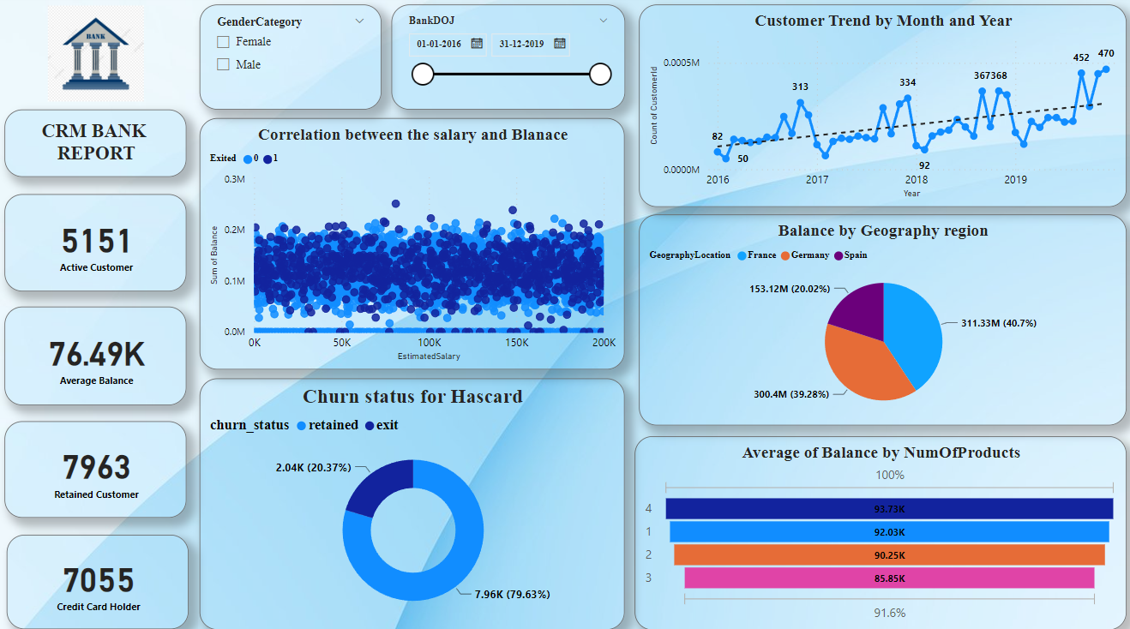
Dashboard

Slide 20
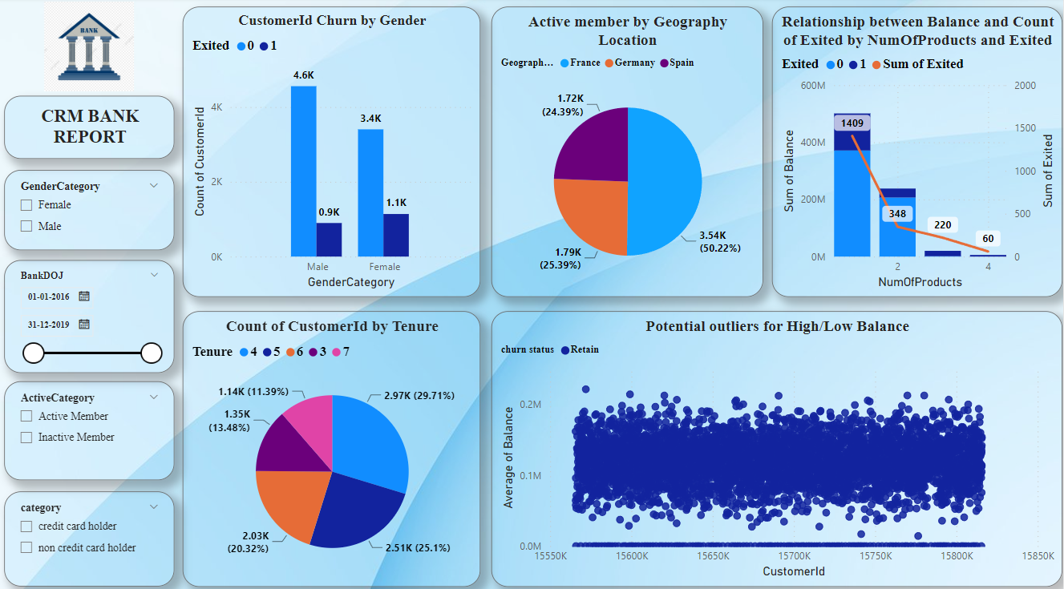
Dashboard 2

Slide 21
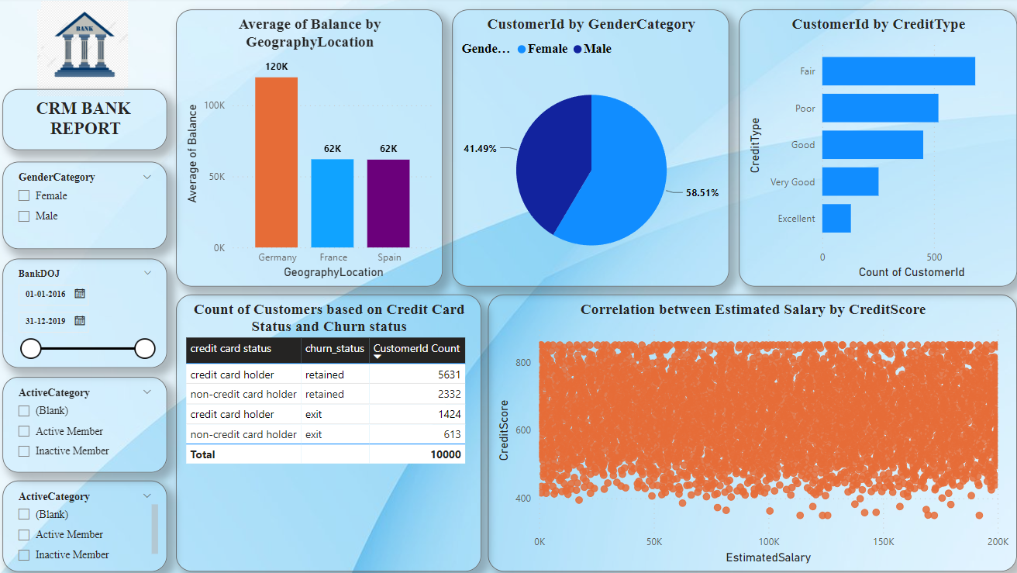
Dashboard

Slide 22
THANK YOU

